Slide 1
Bitcoin Price Prediction
Project 3
Zhou Zhen Jie

Slide 2
Content
Background
Problem Statement
EDA
Model
Confusion Matrix
Conclusion
Q & A

Slide 3
Background
Bitcoin is a decentralized digital currency without any central administrator and can be sent directly from user to user on the bitcoin network. Network nodes verify transactions through cryptography and are recorded in a public distributed ledger called a blockchain which also track ownership, prevent tampering of transaction records, prevent double spending.
Bitcoin gains value based on the community involvement. i.e. Demand and Supply. Currently, demand is more than supply, which impacts price and increases volatility.

Slide 4
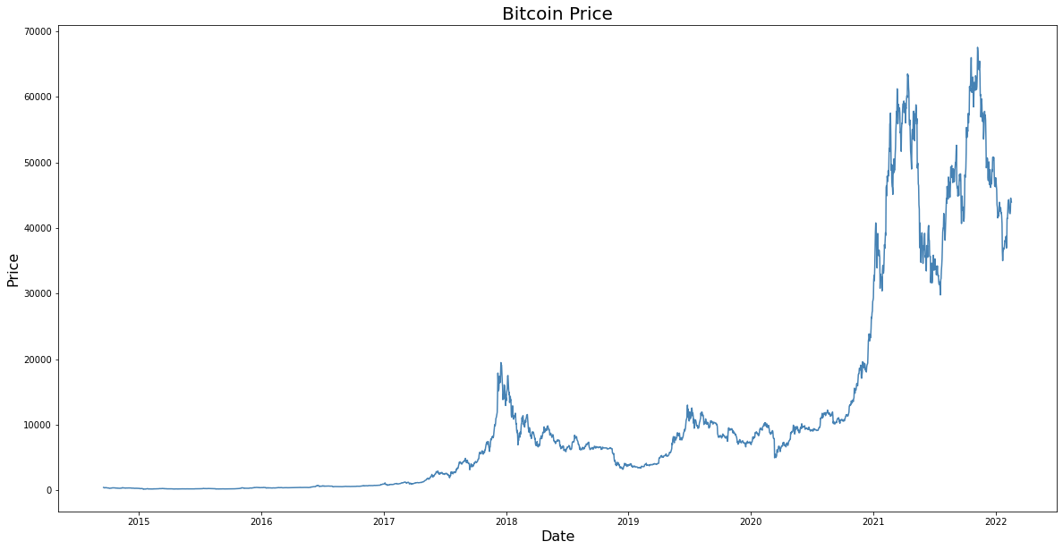

Slide 5
Problem Statement
After the all-time high of Bitcoin with a market capitalization of more than 1,000 Billion dollars in April 2021 and highest in October 2021 at 1,159 Billion dollars.
Many people, including me want to know if the value of bitcoin will keep increasing or if it is a bubble
Predict the Bitcoin price direction

Slide 6
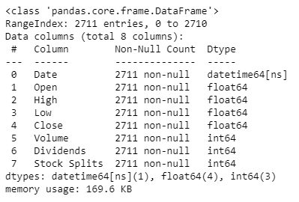
EDA
Imported the data using Yahoo Finance API
The data is from 2014 to today
Consist 2711 row and 7 column

Slide 7
EDA
No Null and Duplicate data
Drop the column ‘Dividends’ and Stock Splits
Add a column name ‘Profit or loss’
We compare the value the column ‘Open’ and ‘Close’ Price
If the ‘Close’ Price is higher than the ‘Open’ price, We consisted that is profit for the day and name it as 1
If the ‘Close’ Price is lower than the ‘Open’ price, We consisted that is loss for the day and name it as 0

Slide 8
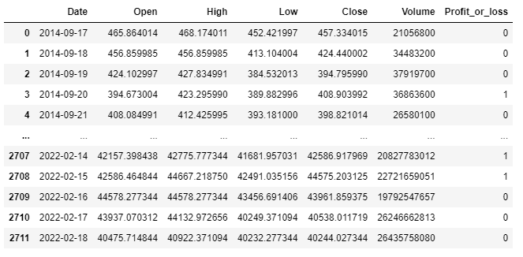

Slide 9
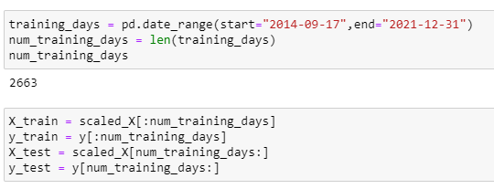
Model
This is a Time Series analysis I have to be caution with my training data
Train my training data from 2014 to 2021 December 31
Test my Test data from 2022 to today

Slide 10
Model
Model | Accuracy score | Precision
Logistic Regression | 0.897 | 0.827
Knn | 0.612 | 0.631
Decision Tree | 0.673 | 0.75
SVM | 0.591 | 0.545
Random Forest | 0.673 | 0.823
XGBoost | 0.714 | 0.777
Base on the accuracy score I use logistic regression to be my model for prediction

Slide 11
Model Prediction
Test Data | Actual | Prediction
0 | 1 | 1
1 | 0 | 0
2 | 0 | 0
3 | 0 | 0
4 | 0 | 0
5 | 0 | 0
6 | 0 | 0
7 | 1 | 1
8 | 1 | 1
9 | 0 | 0
10 | 1 | 1
11 | 1 | 1
12 | 0 | 0
13 | 1 | 1
14 | 1 | 1
15 | 0 | 1
16 | 0 | 0
17 | 1 | 1
Test Data | Actual | Prediction
18 | 0 | 0
19 | 0 | 0
20 | 0 | 0
21 | 0 | 0
22 | 1 | 1
23 | 1 | 1
24 | 1 | 1
25 | 0 | 1
26 | 1 | 1
27 | 1 | 1
28 | 1 | 1
29 | 0 | 0
30 | 1 | 1
31 | 1 | 1
32 | 0 | 0
33 | 1 | 1
34 | 1 | 1
35 | 0 | 1
Test Data | Actual | Prediction
36 | 1 | 1
37 | 1 | 1
38 | 1 | 1
39 | 1 | 1
40 | 0 | 0
41 | 0 | 0
42 | 0 | 1
43 | 0 | 1
44 | 1 | 1
45 | 1 | 1
46 | 0 | 0
47 | 0 | 0
48 | 0 | 0

Slide 12
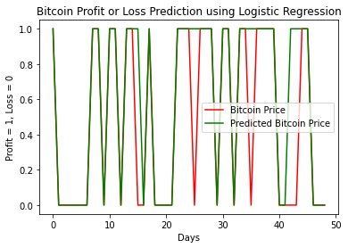
Model Prediction

Slide 13
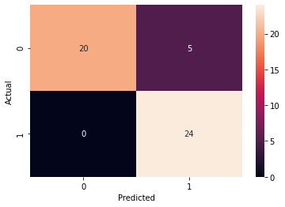
Confusion Matrix
True Positive = 20
False Positive = 5
True Negative = 24
False Negative = 0

Slide 14
Conclusion
The model only predict the price direction
I need to progress from here to predict the price of the bitcoin
There are other factors that will affect the bitcoin price which need to be consider.

Slide 15
Q&A

